Slide 1

ADIDAS PRODUCT SALES ANALYSIS: Overview of Market Performance

Slide 2
Agenda
Introduction
Data exploration and cleaning
Product performance analysis
Retailer analysis
Dashboard view
Summary of key findings
Insights
Recommendations
Conclusions

Slide 3
Introduction: About ADIDAS “Through sport, we have the power to change lives” – ADIDAS Mantra. Inspired by athletes, ADIDAS has created sneakers and apparel worn by world-record holders and medal winners and also the road runners, weekend hikers, recreational soccer players, fitness enthusiasts and all other change-makers around the world. This project is all about ADIDAS products sales analysis and dashboard development for the year 2020 and 2021.

Slide 4

Objective
The objective of this project is to analyze the sales of ADIDAS products by different retailers and evaluate the performance of each product for each retailer.
Analysis Scope
My analysis scope is to develop an interactive dashboard that provides actionable insights for optimizing product distribution, marketing strategies and retailer relationships.

Slide 5
Data Exploration and Cleaning
Data Collection:
Data exploration begins with collecting data from various sources such as databases, APIs or web scraping.
I got my dataset in a csv format from the darey.io website. I studied the acquired data to understand it clearly.
Data Cleaning:
This involved the rectification of outliers, inconsistent data points, and addressing missing values.
Data Analysis:
After familiarizing myself with the data, I used some statistical tools like bar charts, pie chart, etc. on the data. In order to uncover patterns and trends within the data.

Slide 6
Product Performance Analysis
Total revenue generated for the year 2020 and 2021 is $899,902,125. Total profits generated from the product sales of the year 2020 and 2021 is $332,134,761.
Total number of units sold is 2,478,861 products.
For the year 2020 and 2021, men’s street footwear had the highest revenue generated with a total revenue of $37,823,020 with a total operating profit of $15,558,837 for the year 2020, and a total revenue of $171,003,224 with a total operating profit of $67,243,423 for the year 2021.
Overall, men’s street footwear generated the most revenue while women’s athletic footwear generated the least revenue.

Slide 7
Retailer Analysis
Of the total revenue generated for the year 2020 and 2021, west gear retailer had the highest revenue generated with a value of $242,964,333.
Based on regions, the west had the highest revenue generated for the year 2020 and 2021 combined with the month of May indicating the highest revenue generated for both years combined.

Slide 8
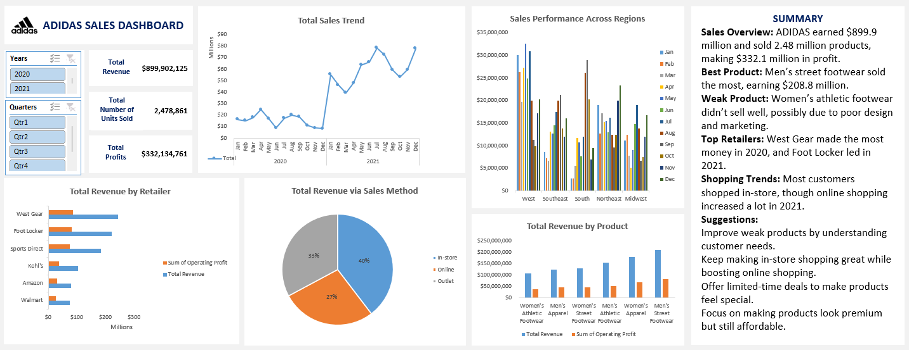

Slide 9
Summary of key findings
This report focuses on ADIDAS sales overview for a period of 2020 and 2021.
For the year 2020, west gear retailer generated the most revenue amounting to $90,299,266, while others followed.
For the year 2021, foot locker retailer generated the most revenue amounting to $177,217,915, while others followed.
For both years combined, men’s street footwear product generated the most revenue valued at $208,826,244, while women’s athletic footwear product had the least revenue generated.
Amongst the three (3) sales method used, in-store method had the most patronage by customers while online and outlet methods had the least.

Slide 10
Insights
The product, men’s street footwear seemed to have been the product that sold the most and generated the most revenue because it solved a problem. It would definitely be an easy wear and quite affordable for customers to afford with a simple but great design and it was mostly purchased from the stores across all regions.
It could suit most outfits, and must be very comfortable to wear. All these allowed customers to connect with the product easily, thereby evoking emotions that foster loyalty and trust. The branding of men’s street footwear must be consistent to pull in the most revenue for both years consecutively. This product has built excitement and desire in the minds of its customers.

Slide 11
Insights continued
On the other hand, the product, women’s athletic footwear generated the least revenue for the both years amongst all other products. This could be owing to the fact that the design and quality may be poor, thorough market research and testing may haven’t been done, poor understanding of the target market and customer needs and poor pricing strategy could all be an issue.
Three (3) methods were used for product sales, which are in-store, online and outlet.
Majority of the sales were through the in-store sales method.
For the year 2020, there was a 52% patronage via the in-store with a value of $93,903,000 revenue generated, while online sales method had the least patronage of 2% with a value of $4,519,966 revenue generated.
In the year 2021, it was a 37% patronage for the in-store sales method with a value of $262,740,750 revenue generated, while there was a significant growth in the online patronage amounting to 34% with a value of $243,152,916, and the outlet method with the least generated revenue of 29% valued at $211,927,784.
This means year in year out across all regions, customers were more inclined to shop in-store than using the online method or outlets provided.

Slide 12
Recommendations
To improve sales of the other products generating lower revenue, thorough market research to determine what your audience truly needs must be carried out. For example, you can: Ask your audience directly about it via social media, email newsletters. Use surveys to gather more detailed information about their challenges and needs.
A brand identity should be built around a pain point the product eliminates and it must be communicated effectively. For example, with the women’s athletic footwear, is it easy to put on, is it comfortable, are the colors unique and attractive, can they stand the test of time (proper usage), does it make the owner feel athletic even though she may not be a professional athlete. This makes people feel like they are part of something cool and exclusive. Hence, the branding must be strong and consistent (the athletic idea must be imprinted in the mind of the customers).
ADIDAS and its partners (retail stores) must learn to build excitement and desire. This will make customers think of how they need the products in their lives right now.
In today’s world, scarcity sells. Limited time offers or special editions can drive demand and encourage people to act fast. This creates a sense of urgency around your product offering.
In the end, we all want to make profit, so we must create products that feels premium but is cost-effective to make. This would allow ADIDAS make some profit, and customers feel they are getting great value for what they are paying for.

Slide 13
Conclusions
Sales Overview: ADIDAS earned $899.9 million and sold 2.48 million products, making $332.1 million in profit.
Best Product: Men’s street footwear sold the most, earning $208.8 million.
Weak Product: Women’s athletic footwear didn’t sell well, possibly due to poor design and marketing.
Top Retailers: West Gear made the most money in 2020, and Foot Locker led in 2021.
Shopping Trends: Most customers shopped in-store, though online shopping increased a lot in 2021.
Suggestions:
Improve weak products by understanding customer needs.
Keep making in-store shopping great while boosting online shopping.
Offer limited-time deals to make products feel special.
Focus on making products look premium but still affordable.

Slide 14
Thank you
Ebam John Agbor
ebamagbor@gmail.com

